Slide 1

Subroutines, Functions,
and Methods

Slide 2
Sub
Routine
Function Method
Sub Program
Subroutine
Sproc
Sub Procedure
Method
Member Function
Procedure
Callable Unit
Procedure Method

Slide 3
Terms
Subroutine – Doesn’t return a value
Function – Returns a value
Method – A subroutine or function inside a class

Slide 4
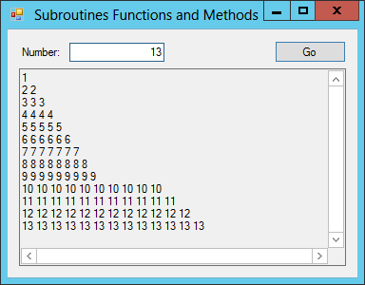
Exercise

